Slide 1
Ki-67 in the Grading of Phyllodes Tumor: A Meta-Analysis
Lucas Torres; Davi Said; Maria Defante; Victoria Alzogaray; Mayara Bearse
Hospital Onofre Lopes (BRA); Universidade de Viçosa (BRA); UniRedentor (BRA); Universidad de la Republica (URU); Yale School of Medicine (USA)

Slide 2
Declaração de Conflito de Interesse
Dr. Lucas Antônio Torres afirma não ter conflito
de interesse a declarar
Exigência da RDC Nº 96/08 da ANVISA

Slide 3
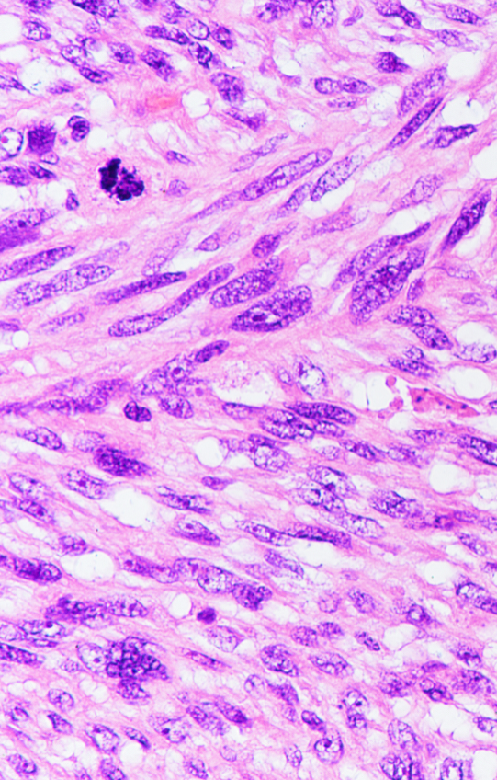
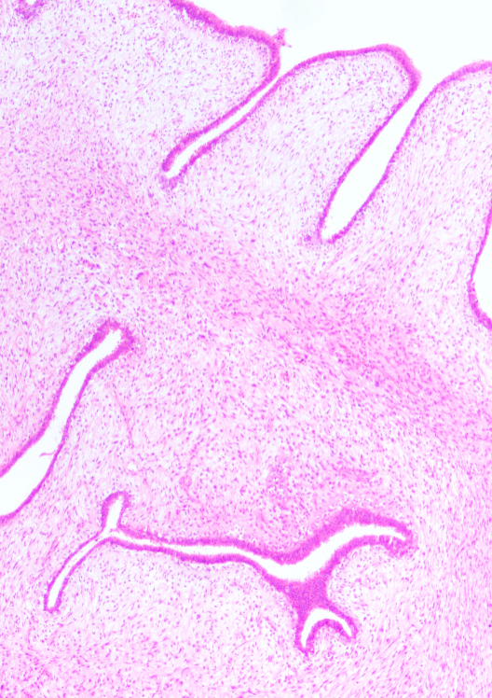
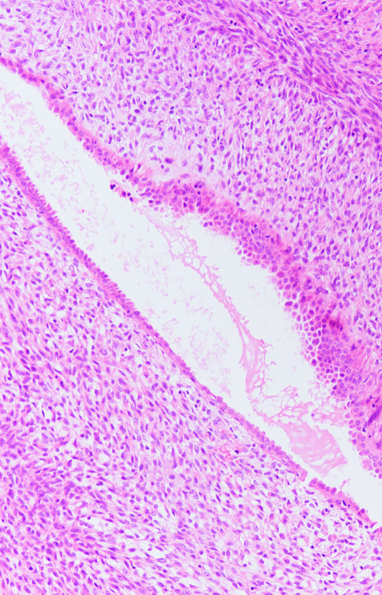
Ki-67 in the Grading of Phyllodes Tumor: A Meta-Analysis
Introduction and objective
Source: World Health Organization (WHO) Classification of Tumours Editorial Board. Breast Tumours. 5th ed., vol. 2, International Agency for Research on Cancer, 2019. ISBN: 978-92-832-4500-1. Available at: https://publications.iarc.fr/Book-And-Report-Series/Who-Classification-Of-Tumours/Breast-Tumours-2019

Slide 4
Ki-67 in the Grading of Phyllodes Tumor: A Meta-Analysis
Introduction and objective
Determining the grade of PT based solely on morphological criteria can sometimes be challenging for the pathologist¹⁻³
Distinguishing borderline PT from their benign or malignant counterparts can be particularly challenging. In the past decade, few studies have highlighted the role of immunohistochemistry panels to aid in the categorization of PTs¹⁻³
Perform a meta-analysis evaluating the correlation between the histological grade of phyllodes tumors and Ki-67 expression
1. Shubham, S., Ahuja, A., & Bhardwaj, M. (2019). Immunohistochemical expression of Ki-67, p53, and CD10 in phyllodes tumor and their correlation with its histological grade. Journal of Laboratory Physicians, 11(4), 330-334. doi:10.4103/JLP.JLP_155_19; 2. Mohd Ali, N. A., Nasaruddin, A., Mohamed, S. S., & Wan Rahman, W. F. (2020). Ki67 and P53 Expression in Relation to Clinicopathological Features in Phyllodes Tumour of the Breast. Asian Pacific Journal of Cancer Prevention, 21(9), 2653-2659. doi:10.31557/APJCP.2020.21.9.2653​; 3. Vilela, M. H. T., de Almeida, F. M., de Paula, G. M., Ribeiro, N. B., Cirqueira, M. B., Silva, A. L., et al. (2014). Utility of Ki-67, CD10, CD34, p53, CD117, and mast cell content in the differential diagnosis of cellular fibroadenomas and in the classification of phyllodes tumors of the breast. International Journal of Surgical Pathology, 22(6), 485-491. doi: 10.1177/1066896914521290.

Slide 5
Ki-67 in the Grading of Phyllodes Tumor: A Meta-Analysis
Materials and methods
Search strategy:
("phyllodes tumor" OR "phyllodes") AND ("marker of proliferation Ki-67" OR MKI67 OR "Ki-67" OR MIB1 OR “MIB-1”) AND (prognostic OR prognosis OR grading OR malignant OR benign OR borderline)
Search on December 30th, 2023
Inclusion criteria:
Randomised studies, not randomised studies, observational studies
That measured ki-67 expression in breast lesions diagnosed as Phyllodes tumor
Reported outcomes of interest

Slide 6
Ki-67 in the Grading of Phyllodes Tumor: A Meta-Analysis
Materials and methods
Outcomes of interest:
Grading of the Phyllodes tumor as benign, borderline or malignant
Exclusion criteria:
Does not fit inclusion criteria
Superimposed population

Slide 7
Ki-67 in the Grading of Phyllodes Tumor: A Meta-Analysis
Materials and methods
PubMed search: 66 results
Identification
Embase search: 173 results
Web of Science search: 50 results
Number screened: 289 results
Screening
Duplicate reports (n = 98)
Excluded by title/abstract (n = 138)
Full-text reviewed: 53 studies
Superimposed population
Eligibility
No outcomes of interest
Other
(n = 36)
Included
17 included studies
Figure 1. PRISMA flow diagram of study screening and selection

Slide 8
Ki-67 in the Grading of Phyllodes Tumor: A Meta-Analysis
Materials and methods
Statistical analysis:
Review Manager 5.4
Odds ratios, with 95% CI
P-values < 0.05 statistically significant
I² statistics to assess heterogeneity
Ki-67 cut-off 10% of positive stromal cells

Slide 9
Ki-67 in the Grading of Phyllodes Tumor: A Meta-Analysis
Materials and methods
Subgroup analysis:
WHO grading system

Slide 10
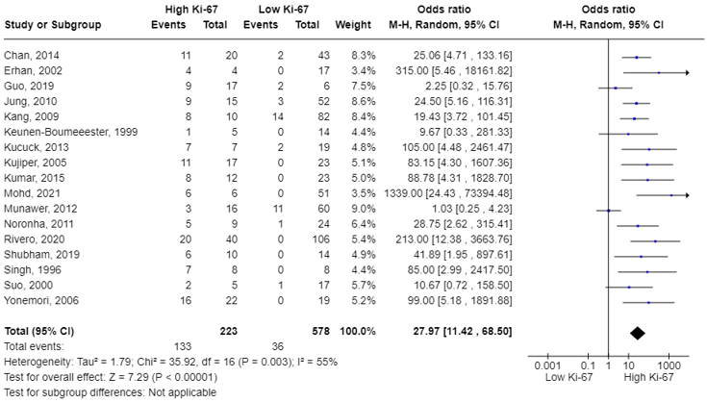
Ki-67 in the Grading of Phyllodes Tumor: A Meta-Analysis
Results and Discussion
Malignant vs. benign plus borderline

Slide 11
Ki-67 in the Grading of Phyllodes Tumor: A Meta-Analysis
Results and Discussion
Ki-67 expression and Phyllodes tumor grading
 | Number of patients (studies) | OR; 95% CI; P value
Malignant vs. benign plus borderline | 801 (17) | 27.97; 11.42-68.50; p<0.00001
Malignant vs. benign plus borderline (WHO) | 452 (8) | 24.14; 4.79-121.65; p=0.001

Slide 12
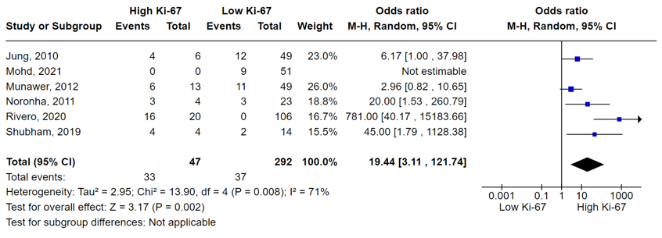
Ki-67 in the Grading of Phyllodes Tumor: A Meta-Analysis
Results and Discussion
Borderline vs. benign

Slide 13
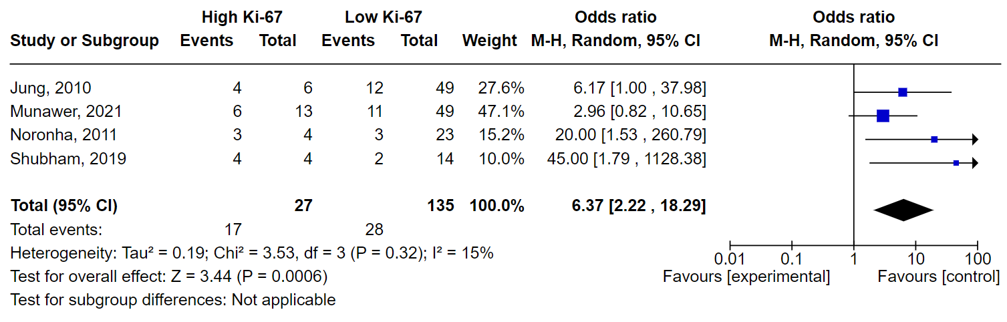
Ki-67 in the Grading of Phyllodes Tumor: A Meta-Analysis
Results and Discussion
Borderline vs. benign
Omitting Rivero, 2020

Slide 14
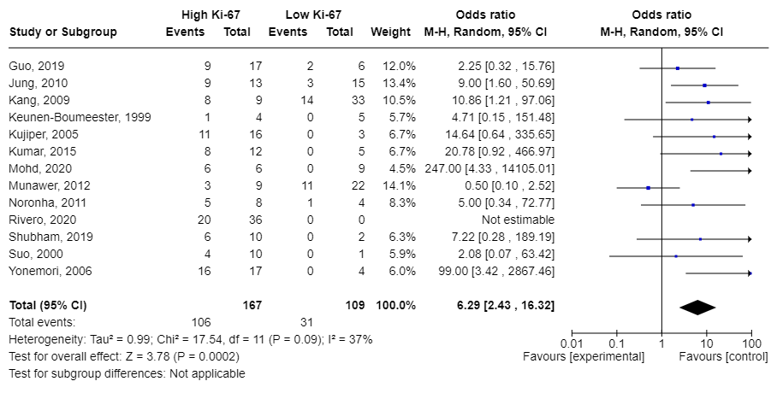
Ki-67 in the Grading of Phyllodes Tumor: A Meta-Analysis
Results and Discussion
Malignant vs. borderline

Slide 15
Ki-67 in the Grading of Phyllodes Tumor: A Meta-Analysis
Conclusion
Malignant phyllodes tumors associated with increased Ki-67 expression compared to benign and borderline tumors
Borderline tumors are associated with increased Ki-67 expression compared to those classified as benign
The data are similar using either the WHO classification for phyllodes tumors or various other classifications
Ki-67 as a tool in the classification of phyllodes tumors of the breast, particularly in challenging cases arising from morphological uncertainty

Slide 16

